Slide 1


Huazhong University of Science and Technology
The Department of Electronics and Information Engineering
Electronic Circuit Analysis and Design
Analysis and Design
Dr. Tianping Deng
Email: dengtp@hust.edu.cn

Slide 2
Contents
PART 1 SEMICONDUCTOR DEVICES AND BASIC APPLICATIONS
Chapter 1 Semiconductor Materials and Diodes
Chapter 2 Diode Circuits
Chapter 3 The Field-Effect Transistor
Chapter 4 Basic FET Amplifiers
Chapter 5 The Bipolar Junction Transistor
Chapter 6 Basic BJT Amplifiers
Chapter 7 Frequency Response
Chapter 8 Output Stages and Power Amplifiers
PART 2 ANALOG ELECTRONICS
Chapter 9 Ideal Operational Amplifiers and Op-Amp Circuits
Chapter 10 Integrated Circuit Biasing and Active Loads
Chapter 11 Differential and Multistage Amplifiers
Chapter 12 Feedback and Stability
Chapter 13 Operational Amplifier Circuits
Chapter 14 Nonideal Effects in Operational Amplifier Circuits
Chapter 15 Applications and Design of Integrated Circuits
Chapter 1 Semiconductor Materials and Diodes

Slide 3
Ch1. Semiconductor Materials and Diodes
1.1 Semiconductor Materials and Properties
1.2 The PN Junction
1.3 Diode Circuits DC Analysis and Models
1.4 Diode Circuits AC Equivalent Circuit
1.5 Other Diode Types
1.6 Design Application: Diode Thermometer
1.7 Summary

Slide 4
1.3 Diode Circuits DC Analysis and Models
1.3.1 Models
1.3.2 DC Analysis

Slide 5
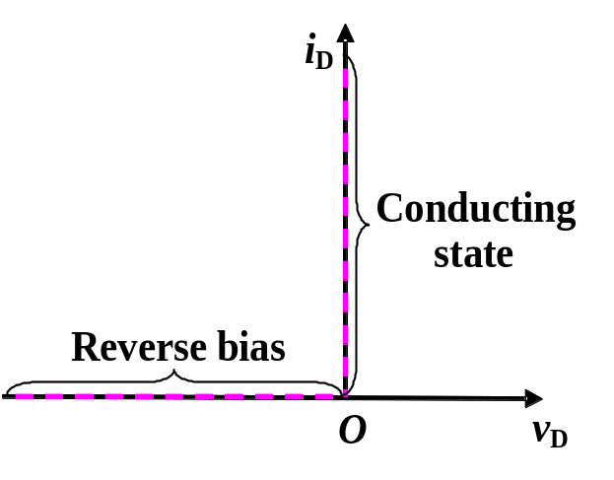
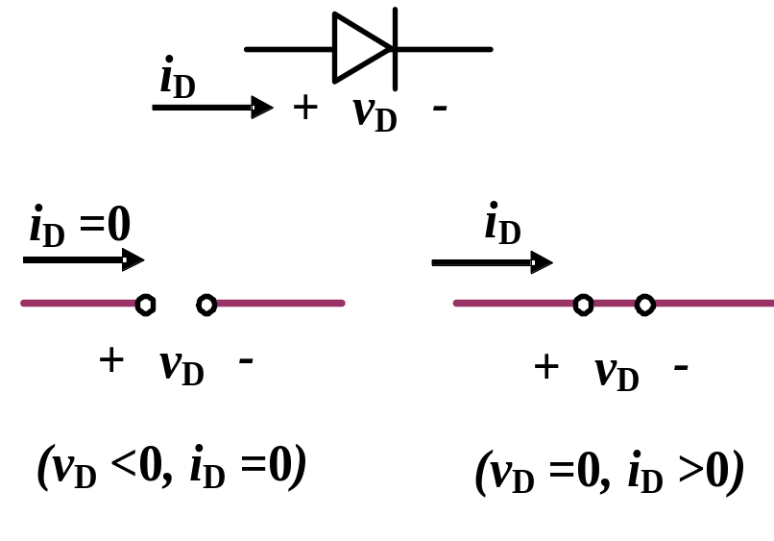
1.3 Diode Circuits_DC Analysis and Models
1.3.1 Models
Describing i-v characteristic, when analyzing circuit
1. Ideal model
(a) (b) (c)

Slide 6
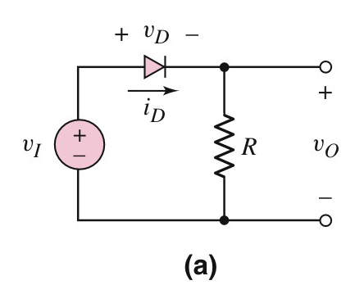
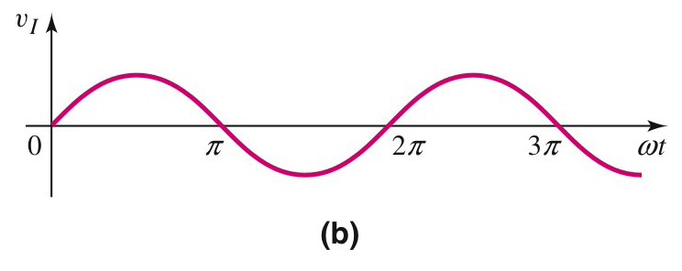
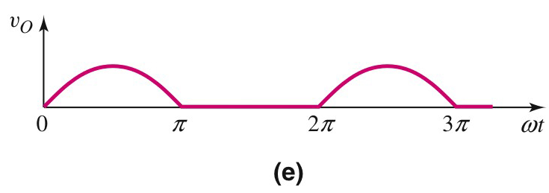


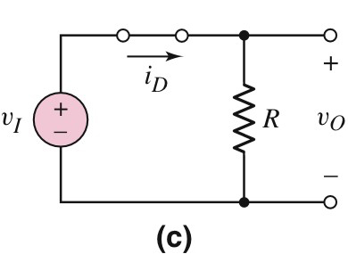
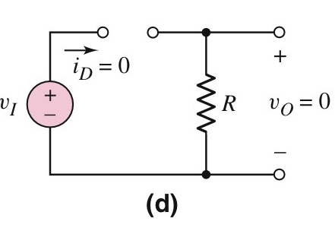
1.3 Diode Circuits_DC Analysis and Models
_{Half wave rectifier}
_{Simulation}

Slide 7
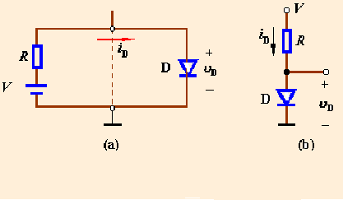
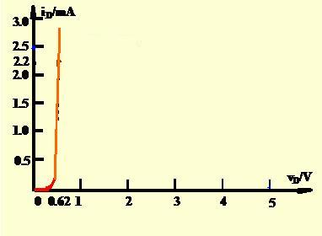
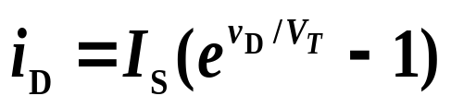


1.3.1 Graphical Analysis
PS
E.g.1.1 Determine the diode voltage and current for the circuit shown in figure, Assume
PS
V_{PS}=5V , R=2kΩ
(1) using the graphical analysis.
(a) Diode circuit
(b) Conventional
图解分析
circuit
Sol: For diode
I_{D}
负载线
For R and V_{PS} branch
_{Simulation}
Find two special points (5V,0mA) and (0V, 2.5mA)
Intersection__quiescent point
or Q-point
V_{D}
静态工作点，直流工作点
交点

Slide 8
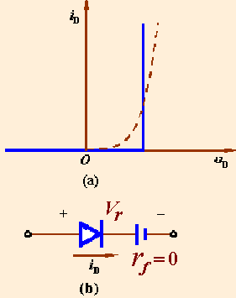
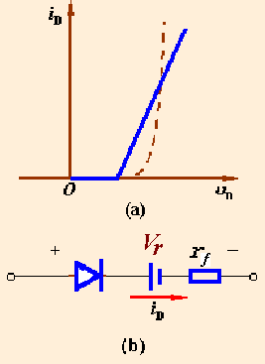
1.3.2 Piecewise model
Two linear approximations
Turn-on voltage
Forward diode resistance
Case 1
Case 2

Slide 9



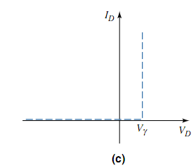
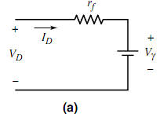
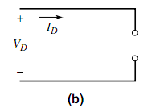
1.3.2 Piecewise model

Slide 10
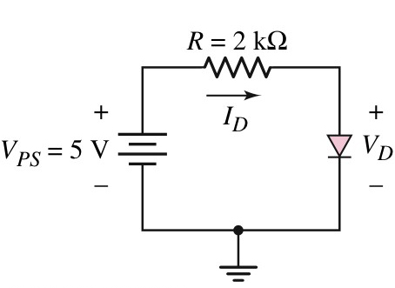
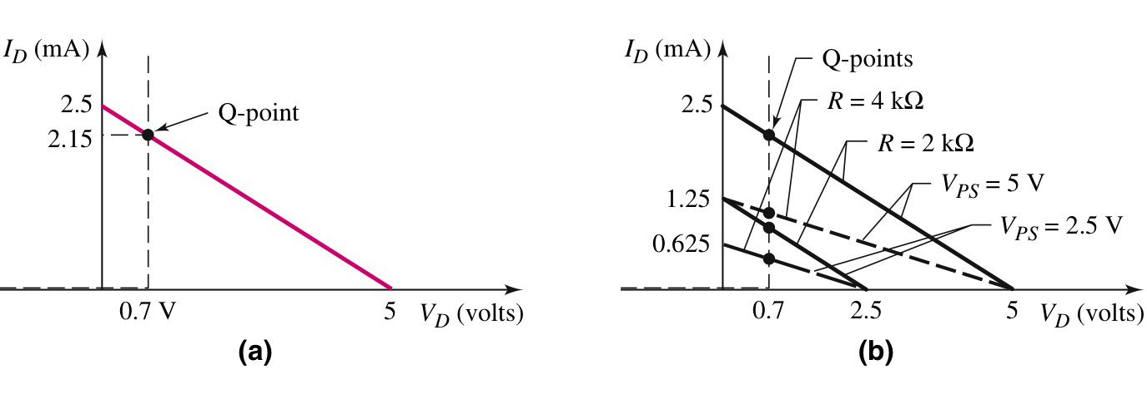
1.3.2 Piecewise model

Slide 11
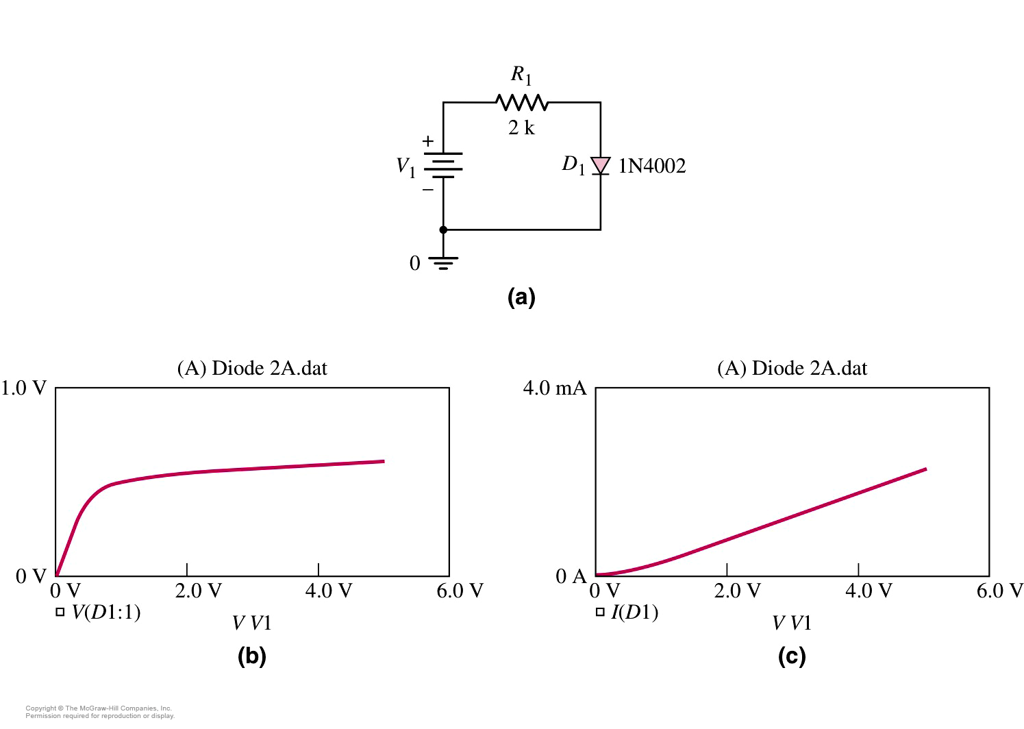
1.3.3 Computer Simulation
Circuit schematic
Diode voltage
Diode current
_{Simulation}
_{Simulation}

Slide 12
Questions
and
Answers

